Slide 1
MELODY METRICS
Group 9:
Prabhleen Kaur (0857194)
Rajwinder Kaur (0831280)
Vindya Senadheera (0857437)
STM Chathurangi (0850982)
Ajay Haji Korbe (0852660)

Slide 2
Introduction
Objective: Predict song popularity on Spotify using audio features.
Target Audience: Artists, producers, and marketers seeking actionable insights.
Data Source: Utilize Spotify's extensive dataset of audio features.
Methodology: Apply EDA and machine learning techniques for analysis.
Outcome: Identify audio features characteristics that define hit songs.

Slide 3
Data Overview
Data Sources : Spotify API, Hugging Face
The dataset had 2409 rows and 20 columns.
There was a null value and 185 duplicates.
The key audio features were danceability, energy, valence, and many more.
Presence of outliers within the audio features

Slide 4
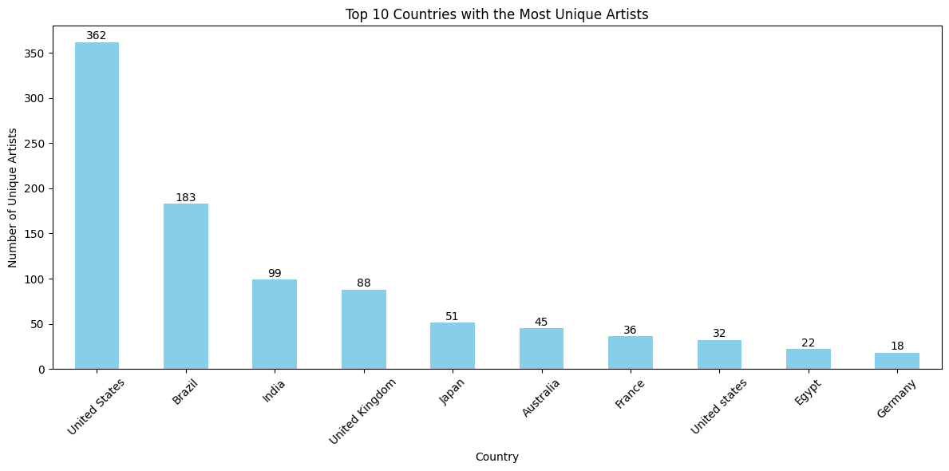
TOP 10 COUNTRIES – NUMBER OF ARTISTS

Slide 5
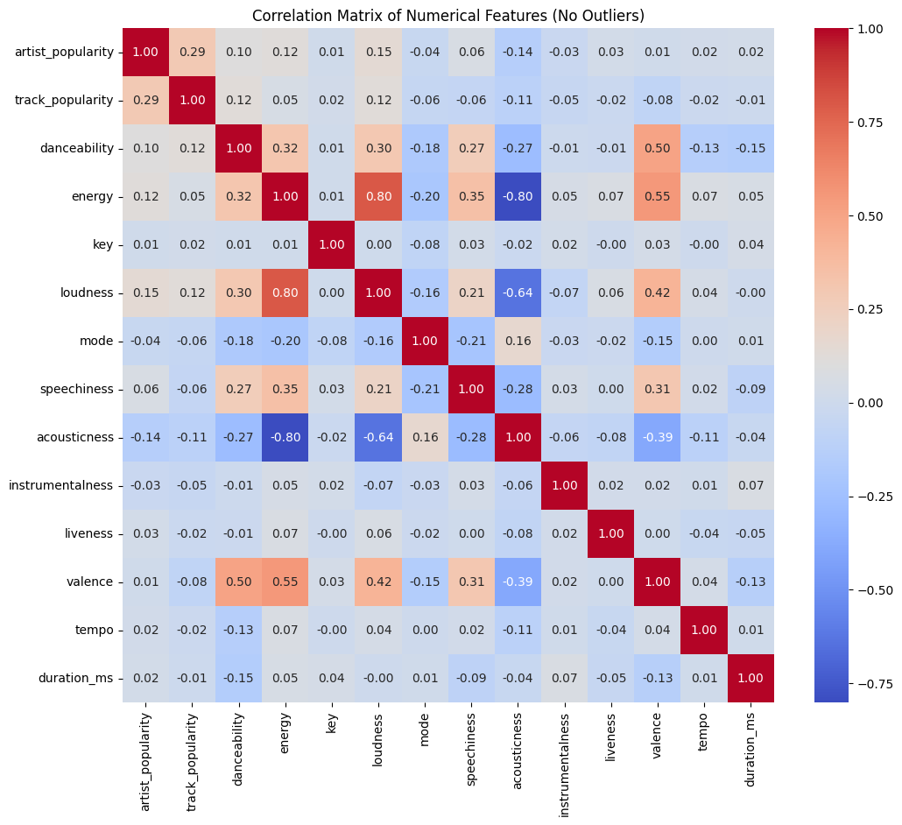
CORRELATION MATRIX OF SPOTIFY AUDIO FEATURES

Slide 6
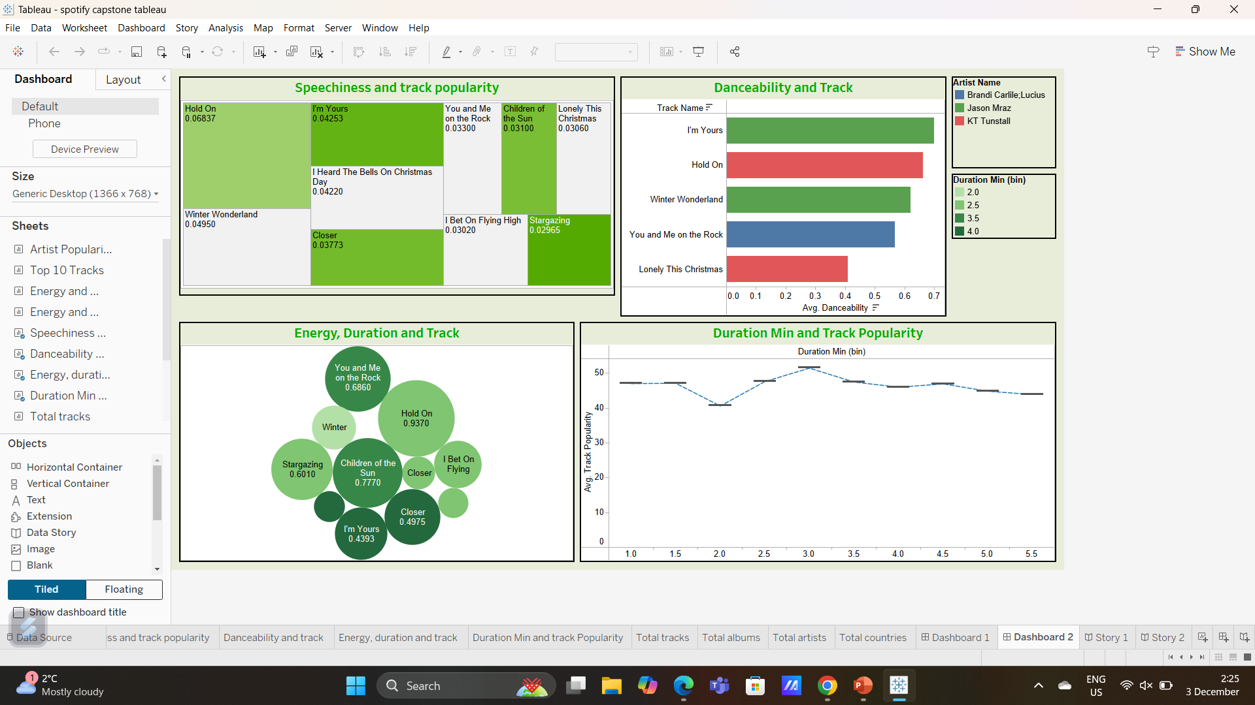
AUDIO FEATURES AND TRACK POPULARITY

Slide 7
Statistical Analysis
✵ Objective: Understand how individual audio features relate to track popularity using the Pearson correlation test.
🎧 Loudness: positive correlation – louder songs tend to be more popular.
💃 Danceability: positive correlation – danceable tracks are slightly more
popular.
⚡ Energy: No correlation – has minimal impact on popularity.
🎻 Acousticness: Negative correlation – acoustic songs tend to be less
popular.

Slide 8
F-TEST:
Conducted to determine if track popularity differs significantly across genres.
The results indicate a statistically significant variation in popularity among different genres.
ONE-TAILED T-TEST:
Performed to test whether popular songs have higher danceability than unpopular songs.
The result confirms that popular tracks tend to have significantly higher danceability than unpopular ones.

Slide 9
Feature Selection
FILTER METHOD:
Applied the Chi-Square test to select the most relevant categorical variables.
Filter methods are fast and model-independent .
WRAPPER METHOD
Iteratively removes less important features to improve model accuracy.
Selected the most relevant features related to track popularity.

Slide 10
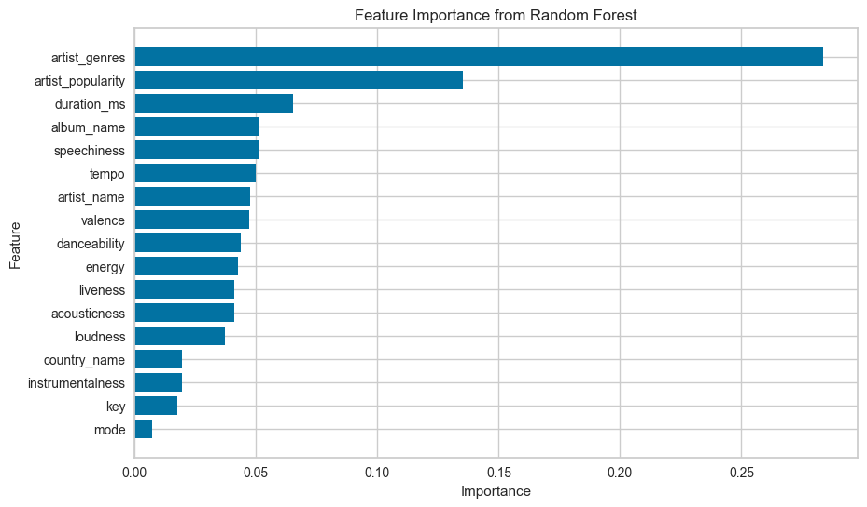
Embedded Method
Automatically identifies key predictors of song popularity by analyzing their impact on model decisions.
Top features identified: artist Genre, Artist name, speechiness, duration, valence.

Slide 11
Model Building
Library used: PyCaret
Hyperparameter Tuning: Improved model performance
Selected Models: Random Forest, XGBoost, and LightGBM were chosen for comparison.
Major Challenge: Building a robust model that could generalize well and selecting important features.

Slide 12
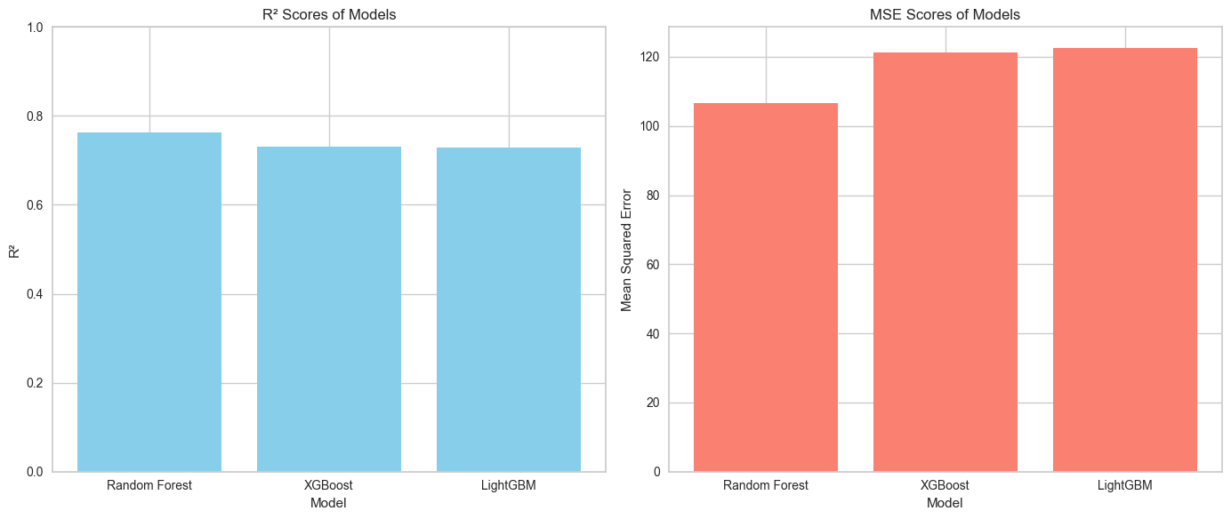
METRICS USED : R SQAURE AND MSE
BEST MODEL : RANDOM FOREST
TEST R SQAURE : 76%
TRAINED R SQAURE : 92%

Slide 13
MODEL DEPLOYMENT
The deployment ensures the model is ready for practical applications, providing accurate predictions for track popularity based on audio features and dataset.
Develop a production-ready solution by deploying the model using platforms like Flask for easy integration with web applications.

Slide 14
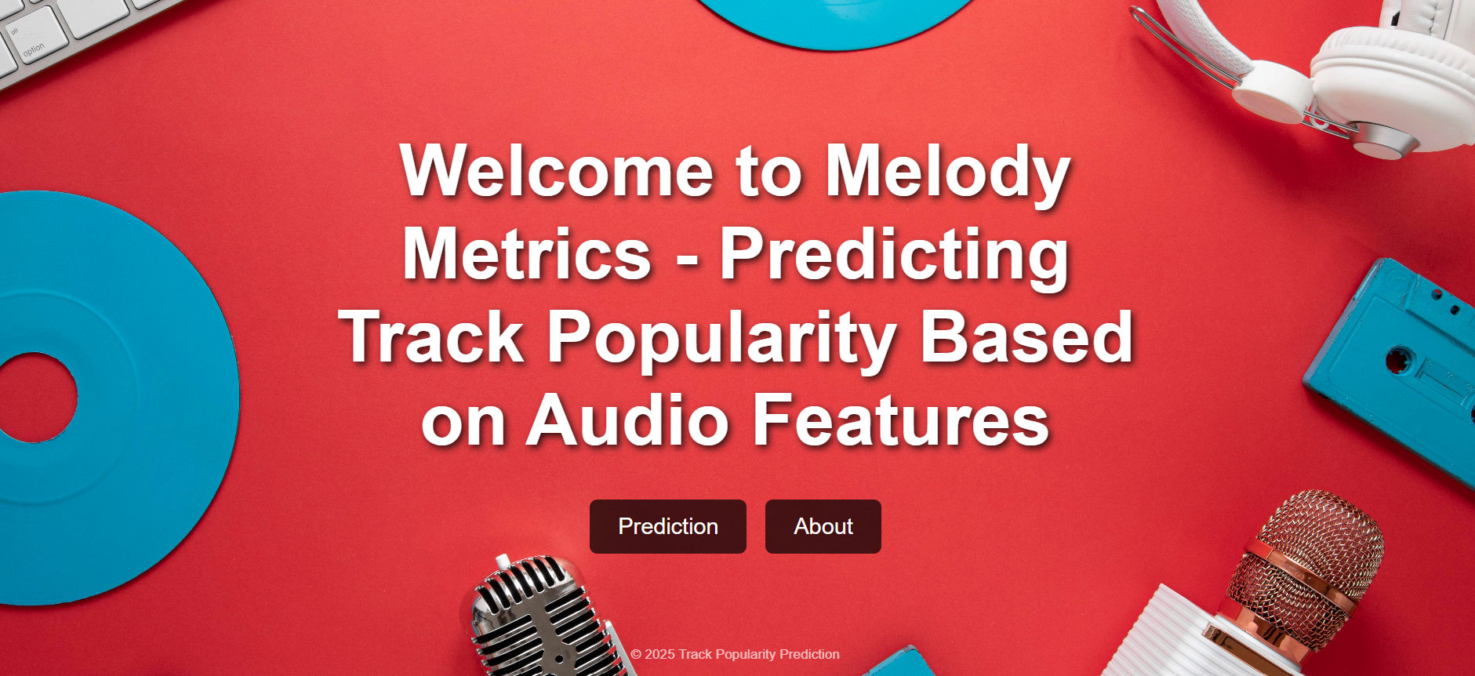

Slide 15


Slide 16
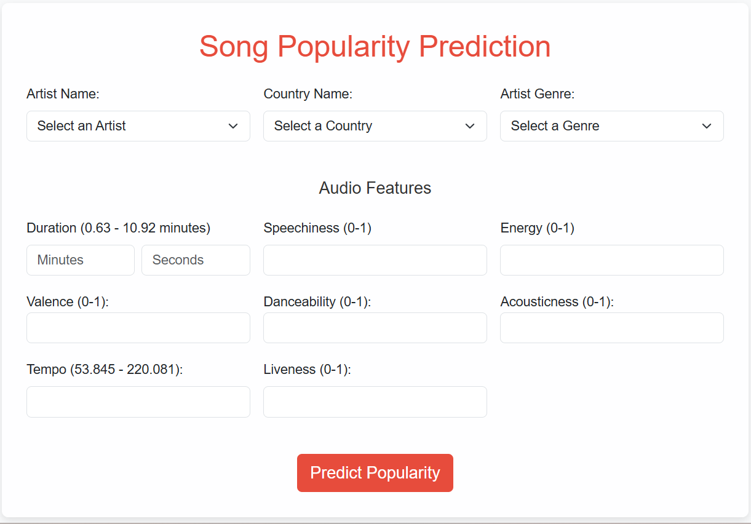

Slide 17
CONCLUSION
Predicting a song’s popularity before release can bring great value to the music industry. With our model:
Music producers can decide which songs to promote more.
Record labels can invest in tracks with higher success potential.
Marketing teams can plan campaigns based on predicted popularity.
Artists get feedback on what works and what doesn’t.
Streaming platforms can improve song recommendations.
Overall, it helps the industry save money, reduce risk, and focus on hits — even before they’re released

Slide 18
Thank You ….

